Slide 1
The Relational Model

Slide 2
Relational model
The relational model is the de facto standard implemented in all the major database systems. It defines:
the format by which data should be stored
the operations for querying the data
A database conforming to the relational model is called a relational database

Slide 3
Relational Database: Definitions
Relational database: a set of relations
Relation: made up of 2 parts:
Instance : a table, with rows and columns.
#Rows = cardinality, #fields = degree / arity.
Schema : specifies name of relation, plus name and type of each column.
E.G. Students(sid: string, name: string, login: string, age: integer, gpa: real).
Can think of a relation as a set of rows or tuples (i.e., all rows are distinct).

Slide 4
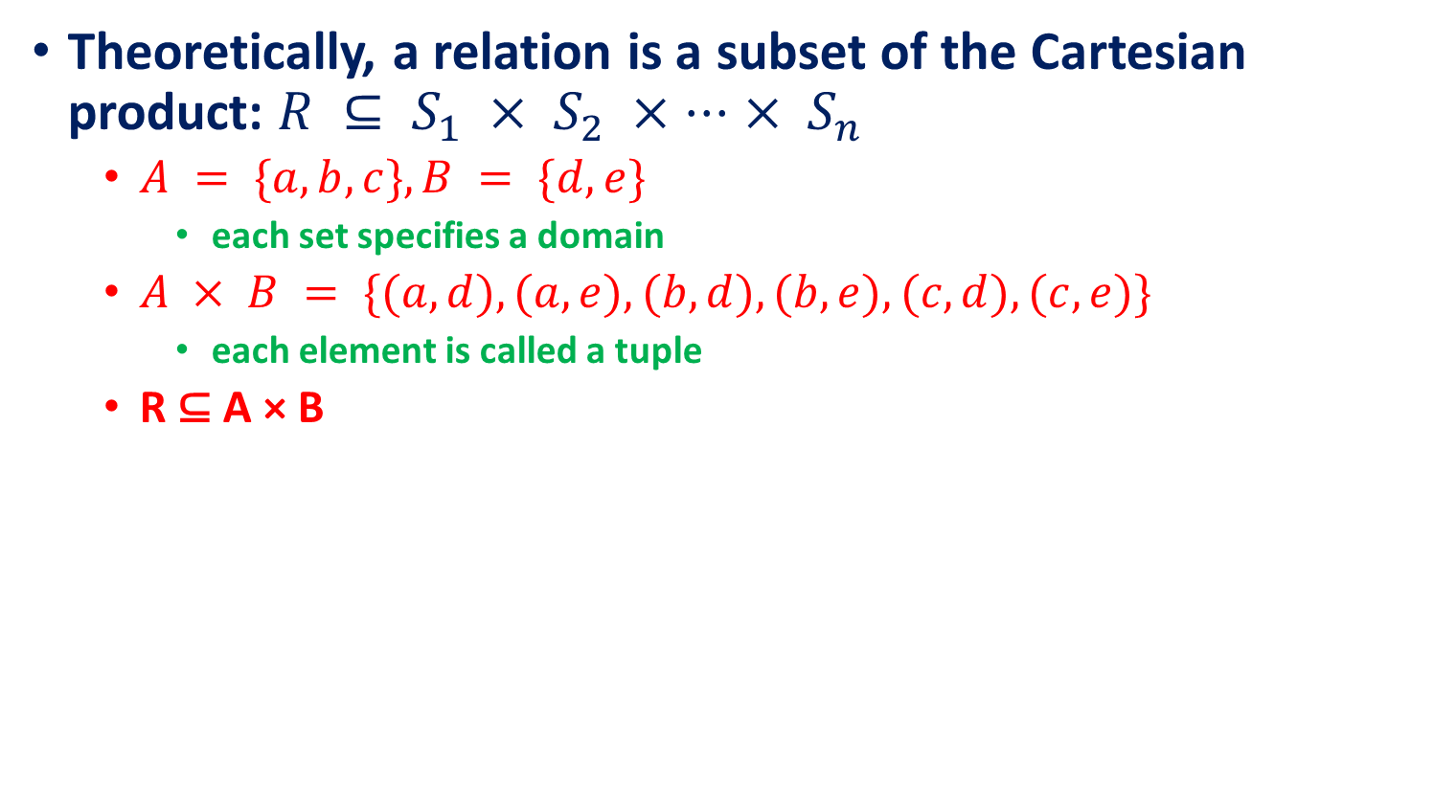
Relational Database: Definitions
Theoretically, a relation is a subset of the Cartesian product: $R ⊆ S_{1} × S_{2} × ⋅⋅⋅ × S_{n}$
$A = \{a, b, c\}, B = \{d, e\}$
each set specifies a domain
$A × B = \{(a,d), (a,e), (b,d), (b,e), (c,d), (c,e)\}$
each element is called a tuple
R ⊆ A × B

Slide 5
Example Instance of Students Relation
Cardinality = 3, degree = 5, all rows distinct

Slide 6
Relational Query Languages
A major strength of the relational model:
supports simple, powerful querying of data.
Queries can be written intuitively, and the DBMS is responsible for efficient evaluation.
The key: precise semantics for relational queries.
Allows the optimizer to extensively re-order operations, and still ensure that the answer does not change.

Slide 7
The SQL Query Language
Developed by IBM (system R) in the 1970s
Need for a standard since it is used by many vendors
Standards:
SQL-86
SQL-89 (minor revision)
SQL-92 (major revision, current standard)
SQL-99 (major extensions)

Slide 8
The SQL Query Language
sid | name | login | age | gpa
53666 | Jones | jones@cs | 18 | 3.4
53688 | Smith | smith@eecs | 18 | 3.2
53650 | Smith | smith@math | 19 | 3.8
To find all 18 year’s old students, we can write:
SELECT *
FROM Students S
WHERE S.age=18;
sid | name | login | age | gpa
53666 | Jones | jones@cs | 18 | 3.4
53688 | Smith | smith@eecs | 18 | 3.2
To find just names and logins:
SELECT S.name, S.login
FROM Students S
WHERE S.age=18;
name | login
Jones | jones@cs
Smith | smith@eecs

Slide 9
Querying Multiple Relations
What does the following query compute?
sid | name | login | age | gpa
53666 | Jones | jones@cs | 18 | 3.4
53688 | Smith | smith@eecs | 18 | 3.2
53650 | Smith | smith@math | 19 | 3.8
Given the following instance of Enrolled:
sid | cid | grade
53831 | Carnatic101 | C
53831 | Reggae203 | B
53650 | Topology112 | A
53666 | History | B
SELECT S.name, E.cid
FROM Students S, Enrolled E
WHERE S.sid=E.sid AND E.grade=“A”;
we get:
S.name | E.cid
Smith | Topology112

Slide 10
Creating Relations in SQL
Creates the Students relation. Observe that the type (domain) of each field is specified, and enforced by the DBMS whenever tuples are added or modified.
As another example, the Enrolled table holds information about courses that students take.
CREATE TABLE Students
(sid CHAR(20),
name CHAR(20),
login CHAR(10),
age INTEGER,
gpa REAL);
sid | name | login | age | gpa
CREATE TABLE Enrolled
(sid CHAR(20),
cid CHAR(20),
grade CHAR(2)) ;
sid | cid | grade
Notes:
15

Slide 11
Destroying and Altering Relations
DROP
Destroys the relation. The schema information and the tuples are deleted.
Syntax: DROP TABLE table_name;
DROP TABLE Students
Destroys the relation Students. The schema information and the tuples are deleted.
ALTER
The ALTER TABLE statement is used to add, delete, or modify columns in an existing table.
The ALTER TABLE statement is also used to add and drop various constraints on an existing table.
ALTER TABLE - ADD Column
Syntax
ALTER TABLE table_name ADD column_name datatype;
sid | name | login | age | gpa
ALTER TABLE Students
ADD firstYear integer;
sid | name | login | age | gpa | firsYear
The schema of Students is altered by adding a new field; every tuple in the current instance is extended with a null value in the new field.
Notes:
16

Slide 12
Destroying and Altering Relations
ALTER TABLE - DROP COLUMN.
SYNTAX
ALTER TABLE table_name DROP COLUMN column_name;
ALTER TABLE Students DROP COLUMN firstYear;
sid | name | login | age | gpa | firsYear
sid | name | login | age | gpa

Slide 13
Destroying and Altering Relations
ALTER TABLE - ALTER/MODIFY COLUMN
SYNTAX
SQL Server / MS Access:
ALTER TABLE table_name ALTER COLUMN column_name datatype;
My SQL / Oracle (prior version 10G):
ALTER TABLE table_name MODIFY COLUMN column_name datatype;
Oracle 10G and later:
ALTER TABLE table_name MODIFY column_name datatype;
ALTER TABLE Students MODIFY COLUMN name varchar(30);

Slide 14
Adding and Deleting Tuples
sid | name | login | age | gpa
53666 | Jones | jones@cs | 18 | 3.4
53688 | Smith | smith@eecs | 18 | 3.2
53650 | Smith | smith@math | 19 | 3.8
Can insert a single tuple using:
INSERT INTO Students (sid, name, login, age, gpa)
VALUES (53688, ‘Vikas’, ‘vikas@ds’, 30, 3.5)
sid | name | login | age | gpa
53666 | Jones | jones@cs | 18 | 3.4
53688 | Smith | smith@eecs | 18 | 3.2
53650 | Smith | smith@math | 19 | 3.8
53688 | Vikas | vikas@ds | 30 | 3.5
Can delete all tuples satisfying some condition (e.g., name = Smith):
DELETE
FROM Students S
WHERE S.name = ‘Smith’
sid | name | login | age | gpa
53666 | Jones | jones@cs | 18 | 3.4
53688 | Vikas | vikas@ds | 30 | 3.5
Powerful variants of these commands are available; more later!
Notes:
10

Slide 15
Updating Tuples
sid | name | login | age | gpa
53666 | Jones | jones@cs | 18 | 3.4
53688 | Smith | smith@eecs | 18 | 3.2
53650 | Smith | smith@math | 19 | 3.8
The UPDATE statement is used to modify the existing records in a table.
UPDATE Syntax
UPDATE table_name SET column1 = value1, column2 = value2, ... WHERE condition;
Example
UPDATE Students SET name = ’Vikas' WHERE sid = 53666;
sid | name | login | age | gpa
53666 | Vikas | jones@cs | 18 | 3.4
53688 | Smith | smith@eecs | 18 | 3.2
53650 | Smith | smith@math | 19 | 3.8
Notes:
10

Slide 16
Integrity Constraints (ICs)
Integrity constraints are a set of rules.
It is used to maintain the quality of information.
Integrity constraints ensure that the data insertion, updating, and other processes have to be performed in such a way that data integrity is not affected.
Referential Integrity
Domain Constraints
Assertions
Triggers
Functional Dependencies
Integrity constraints guard against accidental damage to the database, by ensuring that authorized changes to the database do not result in a loss of data consistency.
Notes:
5

Slide 17
Primary Key
The PRIMARY KEY constraint uniquely identifies each record in a table.
A table can have only one primary key, which may consist of one single or of multiple fields.
MySQL
CREATE TABLE persons
(ID int NOT NULL,
LastName varchar(255) NOT NULL,
FirstName varchar(255) NOT NULL,
Age int,
PRIMARY KEY (ID))
SQL Server / Oracle / MS Access:
CREATE TABLE Persons ( ID int NOT NULL PRIMARY KEY, LastName varchar(255) NOT NULL, FirstName varchar(255), Age int );
MySQL / SQL Server / Oracle / MS Access:
CREATE TABLE Persons ( ID int NOT NULL, LastName varchar(255) NOT NULL, FirstName varchar(255), Age int, CONSTRAINT PK_Person PRIMARY KEY (ID,LastName) );

Slide 18
Candidate Key
In a table, a candidate key is a minimal set K of attributes such that no two tuples are allowed to be equivalent on all the attributes in K.
E.g., in the Students table of the previous slide, if we set {sid} as a candidate key, then no two tuples can have the same sid.
A candidate key is designated when the table is created.

Slide 19
Primary and Candidate Keys in SQL
Possibly many candidate keys (specified using UNIQUE), one of which is chosen as the primary key.
Used carelessly, an IC can prevent the storage of database instances that arise in practice!
CREATE TABLE Enrolled
(sid CHAR(20)
cid CHAR(20),
grade CHAR(2),
PRIMARY KEY (sid,cid) )
CREATE TABLE Enrolled
(sid CHAR(20)
cid CHAR(20),
grade CHAR(2),
PRIMARY KEY (sid),
UNIQUE (cid, grade) )
Notes:
6

Slide 20
Foreign Keys, Referential Integrity
Foreign key : Set of fields in one relation that is used to `refer’ to a tuple in another relation. Like a `logical pointer’.
E.g. sid is a foreign key referring to Students:
Enrolled(sid: string, cid: string, grade: string)
If all foreign key constraints are enforced, referential integrity is achieved, i.e., no dangling references.
Notes:
7

Slide 21
Foreign Keys in SQL
Only students listed in the Students relation should be allowed to enroll for courses.
CREATE TABLE Enrolled
(sid CHAR(20), cid CHAR(20), grade CHAR(2),
PRIMARY KEY (sid,cid),
FOREIGN KEY (sid) REFERENCES students (sid))
Enrolled
Students
Notes:
7

Slide 22
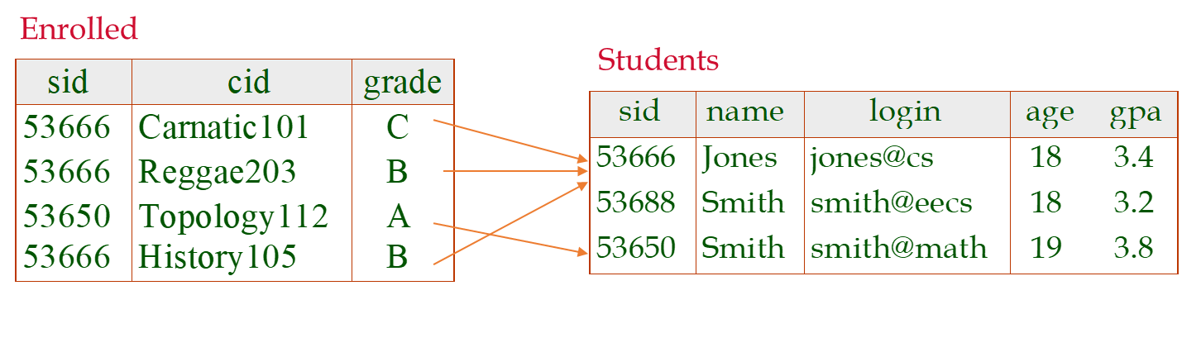
Enforcing Referential Integrity
Consider Students and Enrolled; sid in Enrolled is a foreign key that references Students.
What should be done if an Enrolled tuple with a non-existent student id is inserted? (Reject it!)
What should be done if a Students tuple is deleted?
Also delete all Enrolled tuples that refer to it.
Disallow deletion of a Students tuple that is referred to.
Set sid in Enrolled tuples that refer to it to a default sid.
(In SQL, also: Set sid in Enrolled tuples that refer to it to a special value null, denoting `unknown’ or `inapplicable’.)
Similar if primary key of Students tuple is updated.
Notes:
13

Slide 23
Referential Integrity in SQL/92
SQL/92 supports all 4 options on deletes and updates.
Default is NO ACTION (delete/update is rejected)
CASCADE (also delete all tuples that refer to deleted tuple)
SET NULL / SET DEFAULT (sets foreign key value of referencing tuple)
DELETE CASCADE
When we create a foreign key using this option, it deletes the referencing rows in the child table when the referenced row is deleted in the parent table which has a primary key.
CREATE TABLE Enrolled
(sid CHAR(20),
cid CHAR(20),
grade CHAR(2),
PRIMARY KEY (sid,cid),
FOREIGN KEY (sid)
REFERENCES Students(sid)
ON DELETE CASCADE
ON UPDATE SET DEFAULT )
Notes:
14

Slide 24
Referential Integrity in SQL/92
SQL/92 supports all 4 options on deletes and updates.
Default is NO ACTION (delete/update is rejected)
CASCADE (also delete all tuples that refer to deleted tuple)
SET NULL / SET DEFAULT (sets foreign key value of referencing tuple)
UPDATE CASCADE
When we create a foreign key using UPDATE CASCADE the referencing rows are updated in the child table when the referenced row is updated in the parent table which has a primary key.
CREATE TABLE Enrolled
(sid CHAR(20),
cid CHAR(20),
grade CHAR(2),
PRIMARY KEY (sid,cid),
FOREIGN KEY (sid)
REFERENCES Students(sid)
ON DELETE CASCADE
ON UPDATE SET DEFAULT )
Notes:
14

Slide 25
Referential Integrity in SQL/92
ON DELETE NO ACTION
Raises an error and rolls back the delete action on the row in the parent table.
ON DELETE SET NULL
Sets the rows in the child table to NULL if the corresponding rows in the parent table are deleted. To execute this action, the foreign key columns must be nullable.
ON DELETE SET DEFAULT
Sets the rows in the child table to their default values if the corresponding rows in the parent table are deleted. To execute this action, the foreign key columns must have default definitions. Note that a nullable column has a default value of NULL if no default value specified.
CREATE TABLE Enrolled
(sid CHAR(20),
cid CHAR(20),
grade CHAR(2),
PRIMARY KEY (sid,cid),
FOREIGN KEY (sid)
REFERENCES Students(sid)
ON DELETE CASCADE
ON UPDATE SET DEFAULT )
Notes:
14

Slide 26
Referential Integrity in SQL/92
CREATE TABLE Students
(sid VARCHAR(20), name VARCHAR(20),
login VARCHAR(10), age INTEGER,
gpa REAL,
PRIMARY KEY (sid));
INSERT INTO Students (sid, name, login, age, gpa)
VALUES (53688, "Vikas", "vikas", 30, 3.5);
SELECT * from Students;
CREATE TABLE Enrolled (sid VARCHAR(20), cid VARCHAR(20),
grade VARCHAR(2),
PRIMARY KEY (sid,cid),
FOREIGN KEY (sid)
REFERENCES Students(sid)
ON DELETE SET DEFAULT
ON UPDATE SET DEFAULT);
UPDATE Students SET name = "Vikas Kumar" WHERE sid = 53688;
SELECT * from Students;
ON UPDATE NO ACTION
Raises an error and rolls back the update action on the row in the parent table.
ON UPDATE SET NULL
Sets the rows in the child table to NULL when the corresponding row in the parent table is updated. Note that the foreign key columns must be nullable for this action to execute.
ON UPDATE SET DEFAULT
Sets the default values for the rows in the child table that have the corresponding rows in the parent table updated.
Notes:
14

Slide 27
Views
A view is just a relation, but we store a definition, rather than a set of tuples.
A VIEW is like a virtual table that contains data from one or multiple tables. It does not hold any data and does not exist physically in the database.
CREATE VIEW Name AS
Select column1, Column2...ColumnN From tables
Where conditions;
CREATE VIEW YoungActiveStudents
AS SELECT S.name, E.grade
FROM Students S, Enrolled E
WHERE S.sid = E.sid and S.age<21
Views can be dropped using the DROP VIEW command.
Notes:
18

Slide 28
Views and Security
Views can be used to present necessary information (or a summary), while hiding details in underlying relation(s).
Given YoungStudents, but not Students or Enrolled, we can find students who have are enrolled, but not the cid’s of the courses they are enrolled in.
Notes:
22

Slide 29
Logical DB Design: ER to Relational
Entity sets to tables.
name
ssn
lot
Employees
CREATE TABLE Employees
(ssn CHAR(11),
name CHAR(20),
lot INTEGER,
PRIMARY KEY (ssn))
Notes:
3
The slides for this text are organized into several modules. Each lecture contains about enough material for a 1.25 hour class period. (The time estimate is very approximate--it will vary with the instructor, and lectures also differ in length; so use this as a rough guideline.) This covers Lectures 1 and 2 (of 6) in Module (5).
Module (1): Introduction (DBMS, Relational Model)
Module (2): Storage and File Organizations (Disks, Buffering, Indexes)
Module (3): Database Concepts (Relational Queries, DDL/ICs, Views and Security)
Module (4): Relational Implementation (Query Evaluation, Optimization)
Module (5): Database Design (ER Model, Normalization, Physical Design, Tuning)
Module (6): Transaction Processing (Concurrency Control, Recovery)
Module (7): Advanced Topics

Slide 30
Relationship Sets to Tables
In translating a relationship set to a relation, attributes of the relation must include:
Keys for each participating entity set (as foreign keys).
CREATE TABLE Works_In(
ssn CHAR(1),
did INTEGER,
since DATE,
PRIMARY KEY (ssn, did),
FOREIGN KEY (ssn) REFERENCES Employees,
FOREIGN KEY (did) REFERENCES Departments)
Notes:
5

Slide 31
Review: Key Constraints
Each dept has at most one manager, according to the key constraint on Manages.
since
name
dname
ssn
lot
did
budget
Employees
Manages
Departments
Translation to
relational model?
1-to-1
1-to Many
Many-to-1
Many-to-Many
Notes:
6

Slide 32
Translating ER Diagrams with Key Constraints
Map relationship to a table:
Note that did is the key now!
Separate tables for Employees and Departments.
Since each department has a unique manager, we could instead combine Manages and Departments.
CREATE TABLE Manages(
ssn CHAR(11),
did INTEGER,
since DATE,
PRIMARY KEY (did),
FOREIGN KEY (ssn) REFERENCES Employees,
FOREIGN KEY (did) REFERENCES Departments)
CREATE TABLE Dept_Mgr(
did INTEGER,
dname CHAR(20),
budget REAL,
ssn CHAR(11),
since DATE,
PRIMARY KEY (did),
FOREIGN KEY (ssn) REFERENCES Employees)
Notes:
7

Slide 33
Review: Weak Entities
A weak entity can be identified uniquely only by considering the primary key of another (owner) entity.
Owner entity set and weak entity set must participate in a one-to-many relationship set (1 owner, many weak entities).
Weak entity set must have total participation in this identifying relationship set.
name
ssn
lot
cost
pname
age
Employees
Policy
Dependents
Notes:
10

Slide 34
Translating Weak Entity Sets
Weak entity set and identifying relationship set are translated into a single table.
When the owner entity is deleted, all owned weak entities must also be deleted.
CREATE TABLE Dep_Policy (
pname CHAR(20),
age INTEGER,
cost REAL,
ssn CHAR(11) NOT NULL,
PRIMARY KEY (pname, ssn),
FOREIGN KEY (ssn) REFERENCES Employees,
ON DELETE CASCADE)
Notes:
11

Slide 35
Review: ISA Hierarchies
Overlap constraints: Can Joe be an Hourly_Emps as well as a Contract_Emps entity? (Allowed/disallowed)
Covering constraints: Does every Employees entity also have to be an Hourly_Emps or a Contract_Emps entity? (Yes/no)
name
ssn
lot
Employees
hourly_wages
hours_worked
As in C++, or other PLs, attributes are inherited.
If we declare A ISA B, every A entity is also considered to be a B entity.
ISA
contractid
Hourly_Emps
Contract_Emps
Notes:
12

Slide 36
Translating ISA Hierarchies to Relations
General approach:
3 relations: Employees, Hourly_Emps and Contract_Emps.
Hourly_Emps: Every employee is recorded in Employees. For hourly emps, extra info recorded in Hourly_Emps (hourly_wages, hours_worked, ssn); must delete Hourly_Emps tuple if referenced Employees tuple is deleted).
Queries involving all employees easy, those involving just Hourly_Emps require a join to get some attributes.
Alternative: Just Hourly_Emps and Contract_Emps.
Hourly_Emps: ssn, name, lot, hourly_wages, hours_worked.
Each employee must be in one of these two subclasses.
Notes:
13

Slide 37
Relational Model: Summary
A tabular representation of data.
Simple and intuitive, currently the most widely used.
Integrity constraints can be specified by the DBA, based on application semantics. DBMS checks for violations.
Two important ICs: primary and foreign keys
In addition, we always have domain constraints.
Powerful and natural query languages exist.
Rules to translate ER to relational model
Notes:
15

Slide 38
References
Adhsakkdi Y Raghuram Krishnan and Johannes Gehrke, Database Management Systems, 3/e, TMH, 2007.
Some of the figures and Examples are taken from various online sources.

